Slide 1
GitHub Repository - Team 2
Submitted by:
Devanshi Trivedi (013530530)
Keerthi Akella (013858819)
Nithin Gollanapally (013820599)
Thinh Manh(012050571)
Rajesh Thummala (013829179)
Siddarth Varanasi (013854295)

Slide 2
Project Introduction
Application is a version control tool for coders and developers.
Many times, it happens that the programmer wants to revert to a change he made. Commit comes in.
Coders can also follow each other and can be inspired by others work.

Slide 3
Technologies
Database engine: MySQL
DB application technologies: JDBC, JAVA, Log 4J
Languages: Java
DB access technology: JDBC 6.0

Slide 4
Sign up, Login
Sign up an account with user’s details .
After signing up, their information will be stored into database
Users must provide correct email and password to log in
After successful login, user can access the application

Slide 5
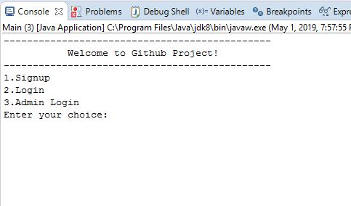

Slide 6
Repository
What is a Repository ?
How to create a Repository?
View Repositories.
What does a Repository contain?

Slide 7
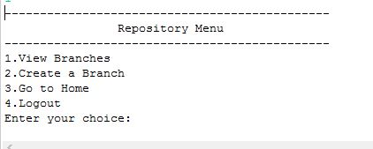

Slide 8
Branch
What is a Branch?
How to create a Branch?
View Branches
What does a branch contain?

Slide 9
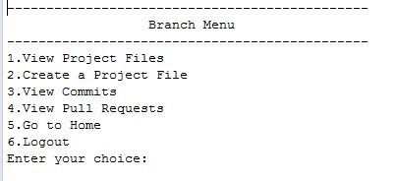

Slide 10
Project Files
What are Project Files?
How to create a Project File?
View Project Files.
What does a project file contain?
Commit and Pull request on project files.

Slide 11
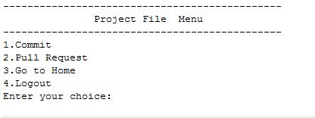

Slide 12
View Followers, View Following, Follow an user
How to view user’s followers?
Whom all the user is following?
How to follow an user?

Slide 13
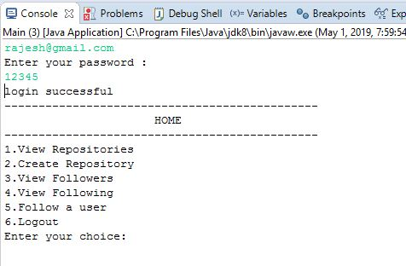

Slide 14
Admin login
How to delete an user?
How to delete a repository?
How to rename a repository?
How to rename a branch?

Slide 15
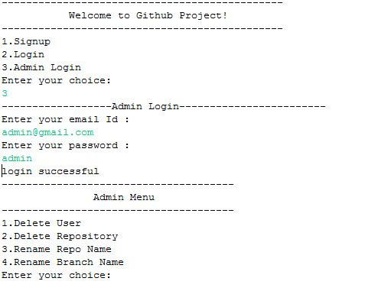

Slide 16
Questions?

Slide 17
Thank You for Listening

